Slide 1
Chipathon Design - ASGARD
Block ORCA_TOP
TEAM MEMBERS:
Nhat Tan (Leader)
Anh Minh
Cong Danh
Van Anh
GROUP 4 - ASGARD
Tuesday, August 26, 2025

Slide 2
Agenda
Synthesis – Floorplan
PnR Flow
STA
Chip – Finish
LEC
Conclusion

Slide 3
Task distribution
Nhat Tan: Floorplaning, STA.
Van Anh: Floorplaning, PV.
Anh Minh: LEC, STA.
Danh: LEC, STA.

Slide 4
1. Synthesis - Floorplan
Block ORCA_TOP

Slide 5
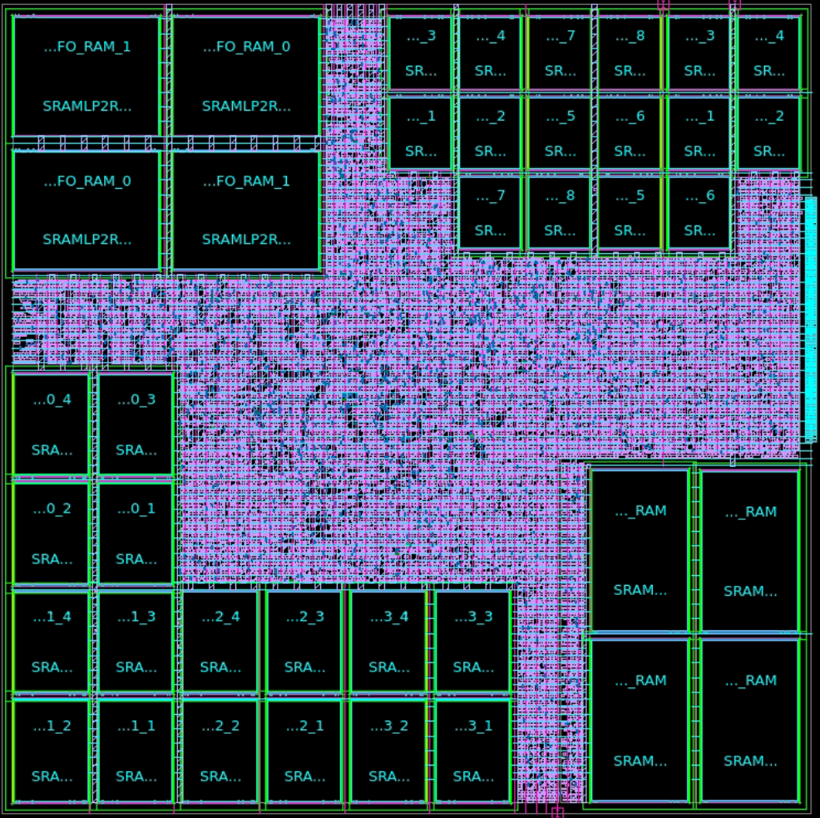
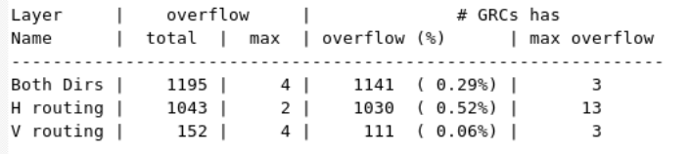
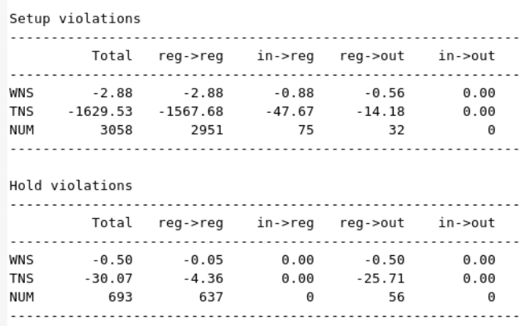
Floorplan After SPG

Slide 6
2. PnR Flow
Block ORCA_TOP

Slide 7
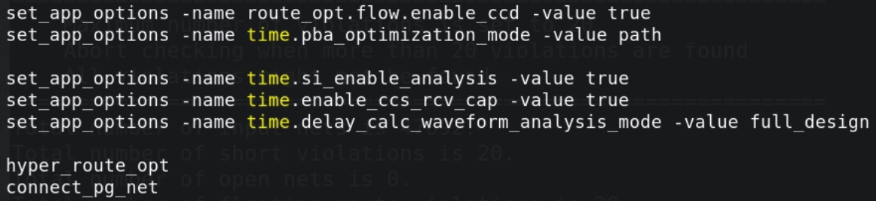

Slide 8
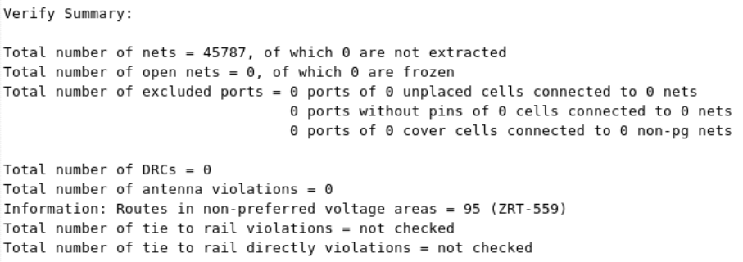
Check_Routes - ICC2

Slide 9
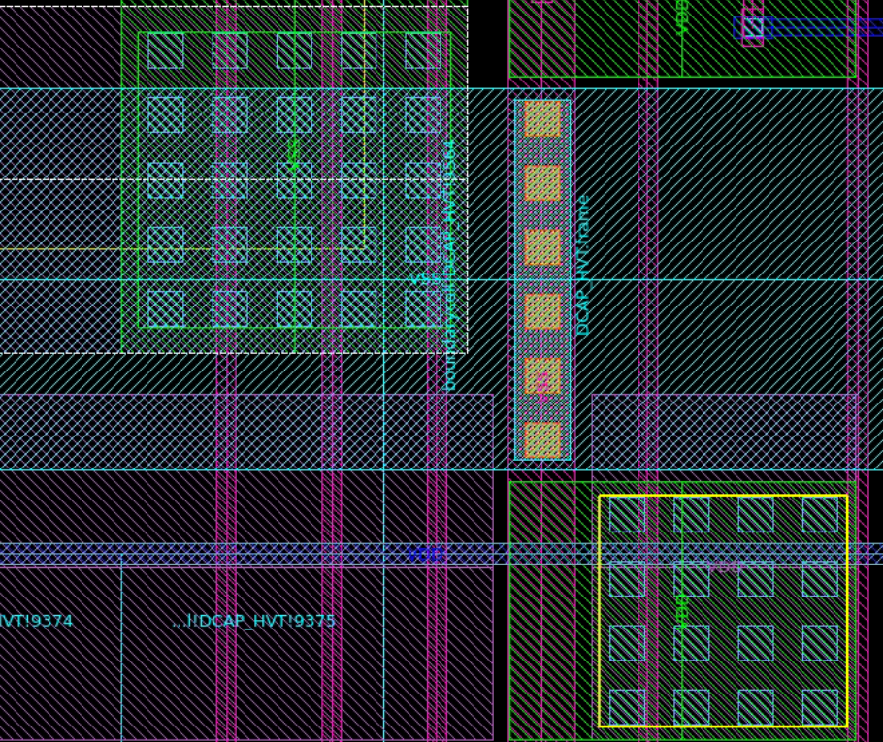
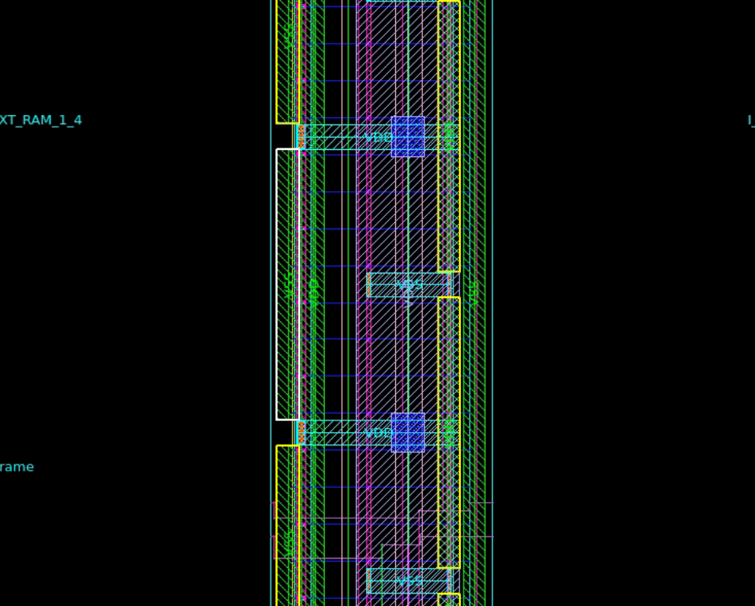
Check_pg_connectivity – ICC2

Slide 10
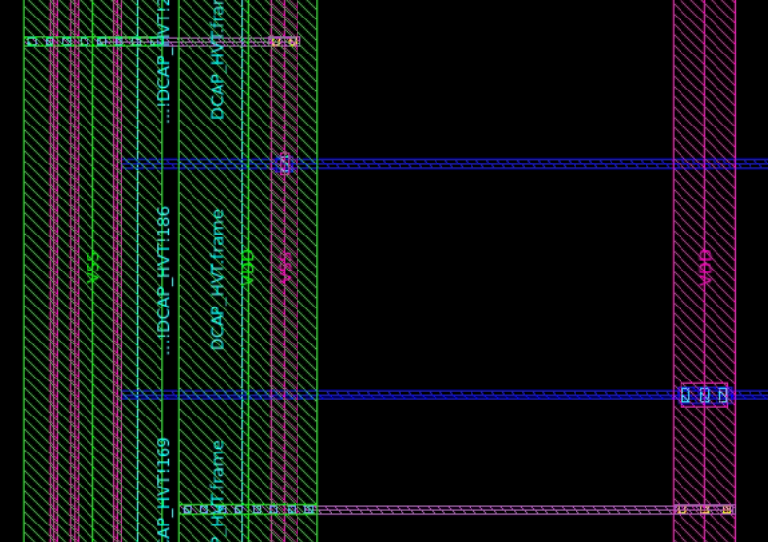
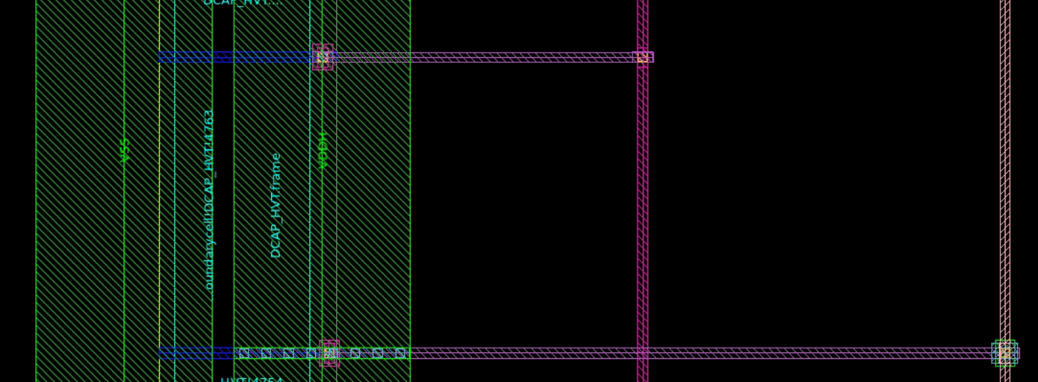
Check_pg_connectivity – ICC2

Slide 11
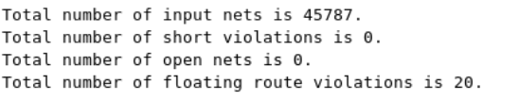
Check_lvs – ICC2

Slide 12
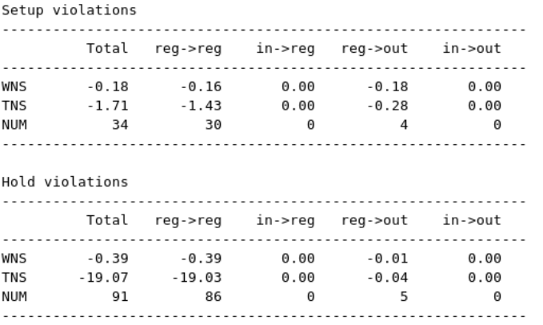
REPORT_GLOBAL_TIMING

Slide 13
3. STA
Block ORCA_TOP

Slide 14
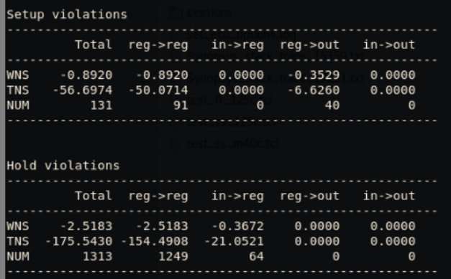
REPORT_GLOBAL_TIMING

Slide 15
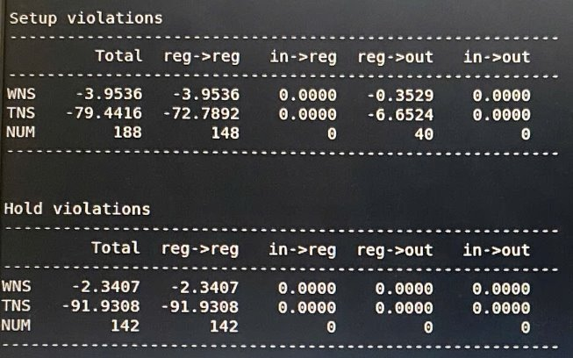
FIX_ECO

Slide 16
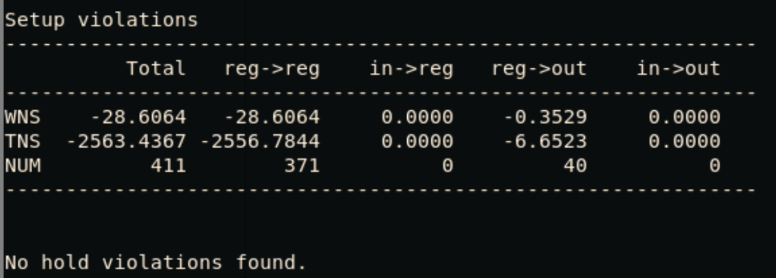
FIX_TIMING

Slide 17
5. CHIP - FINISH
Block ORCA_TOP

Slide 18
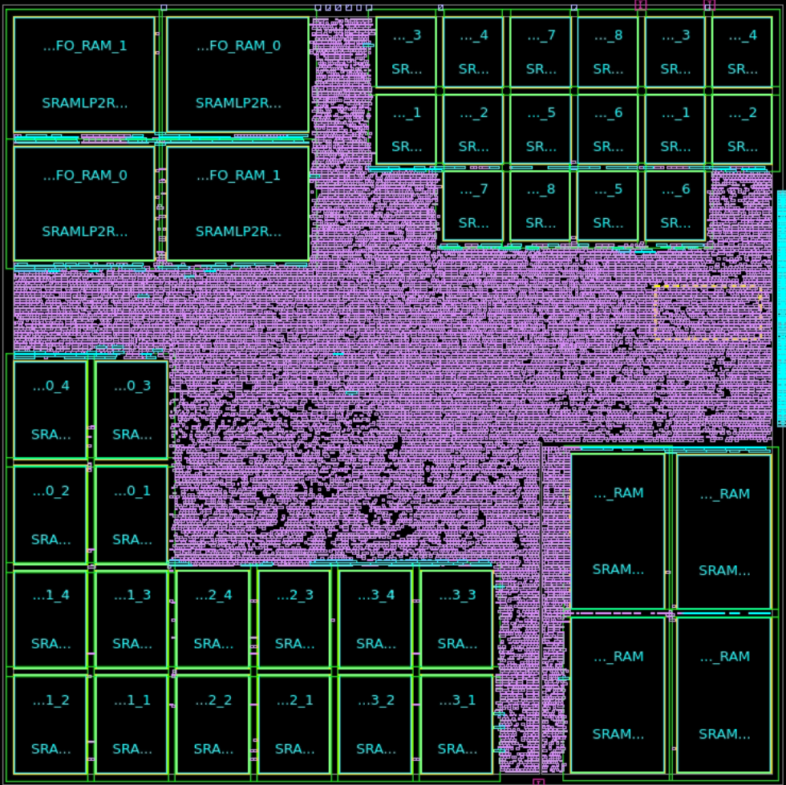
CHIP_FINISH – REPORT_GLOBAL_TIMING

Slide 19
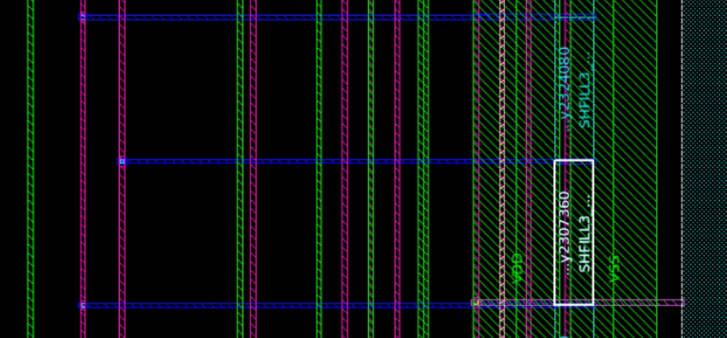
Fix Open

Slide 20
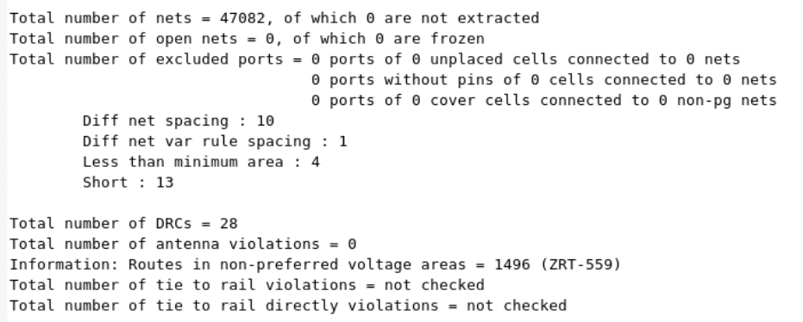
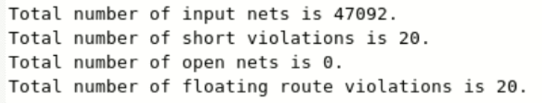
Check_routes – Check_lvs

Slide 21
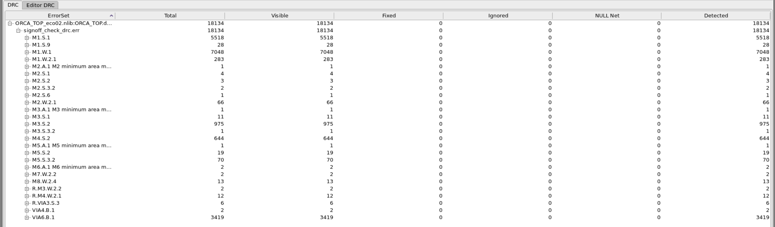
Signoff_CheckDRC - Before

Slide 22
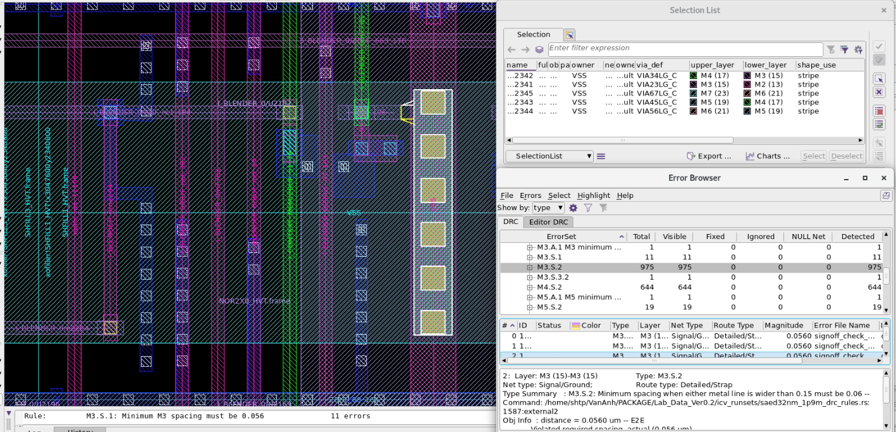
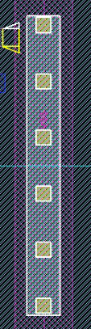
Fix Signoff_CheckDRC

Slide 23
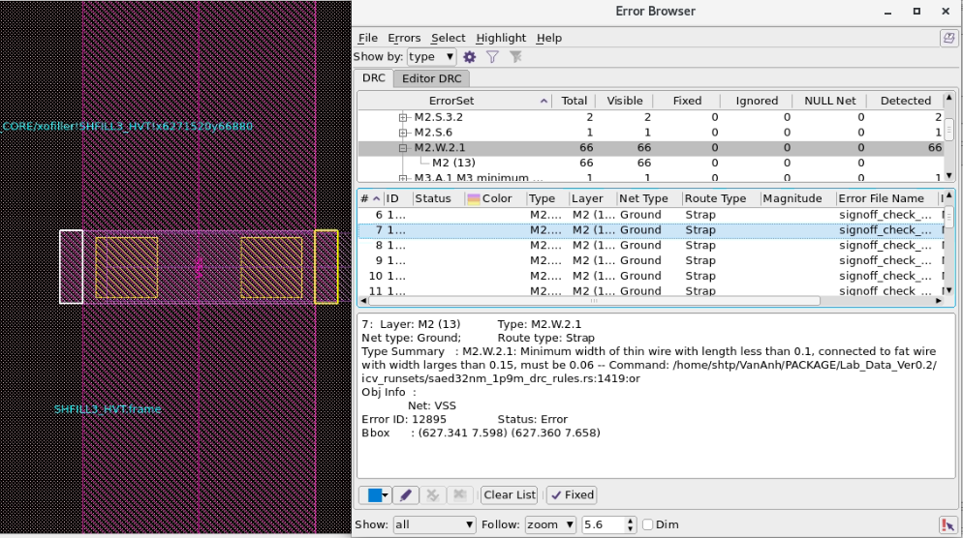
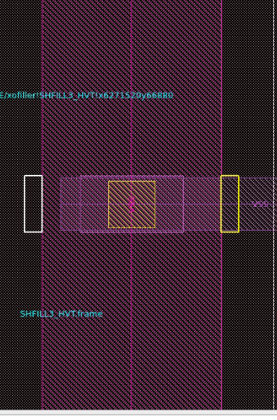
Fix Signoff_CheckDRC

Slide 24
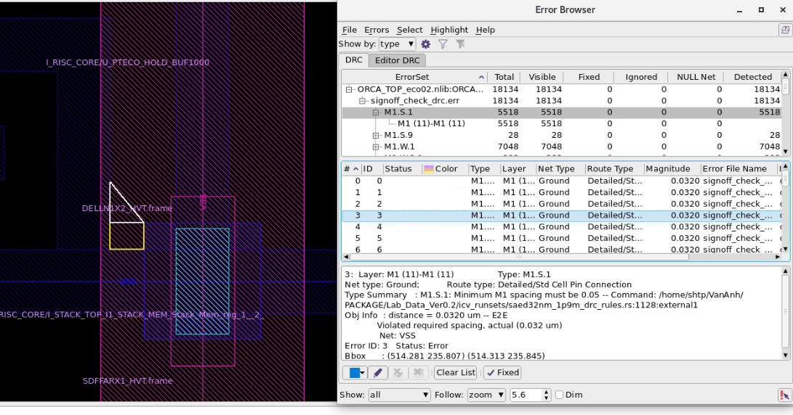
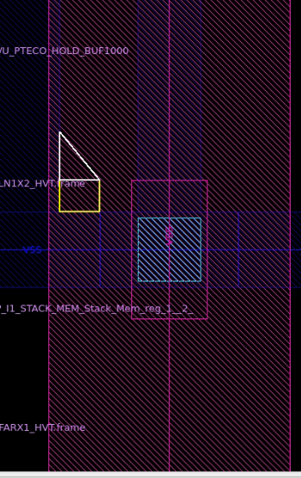
Fix Signoff_CheckDRC

Slide 25
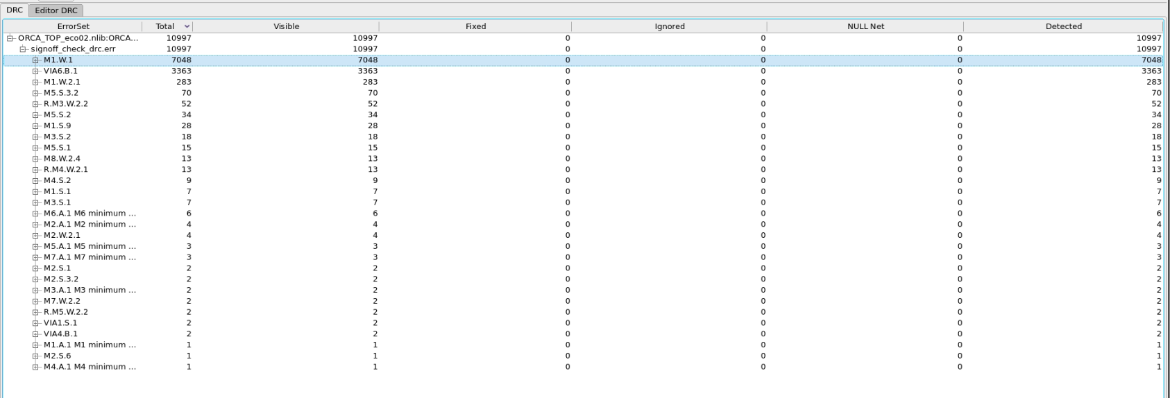
Signoff_CheckDRC – Affter Fixed

Slide 26
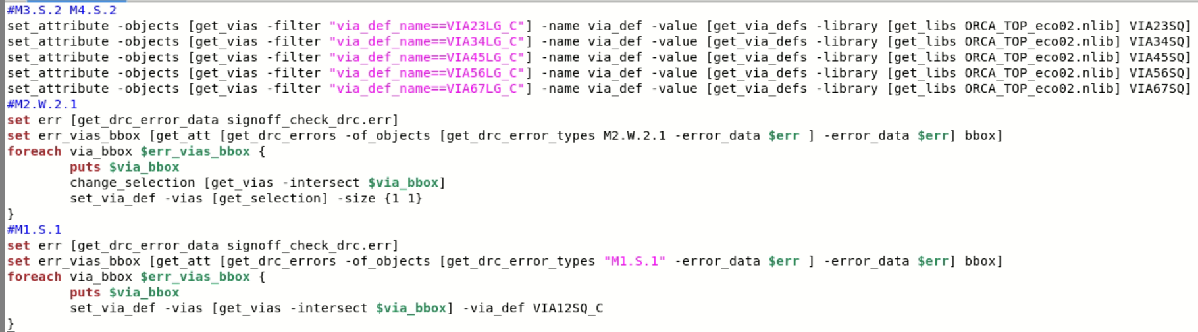
Script to fix DRC

Slide 27
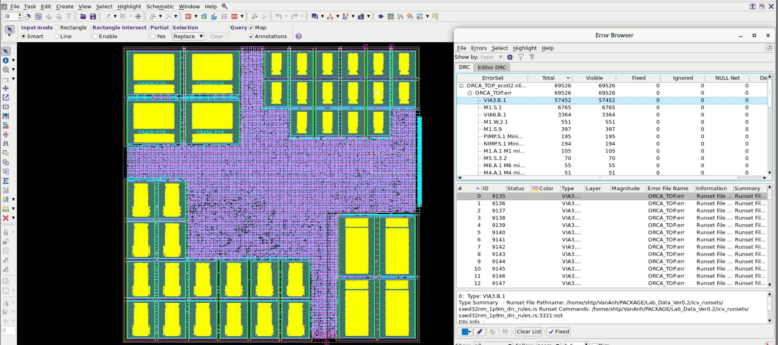
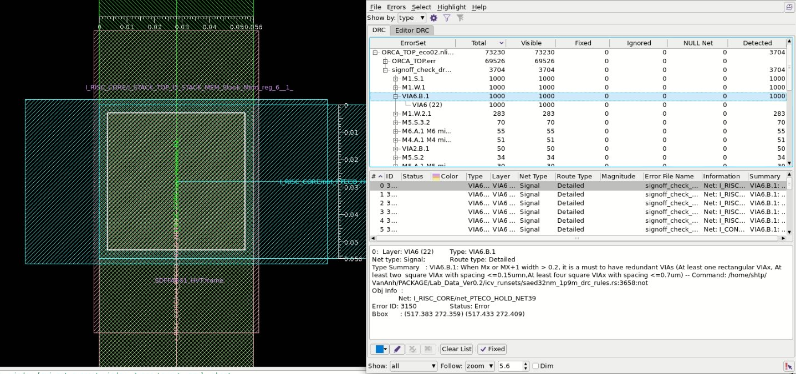
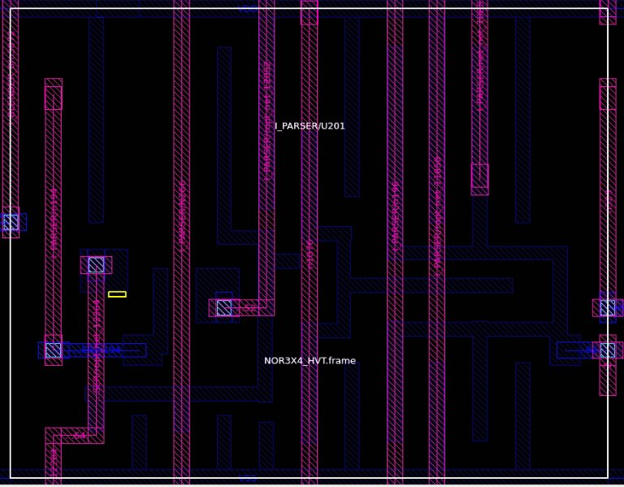
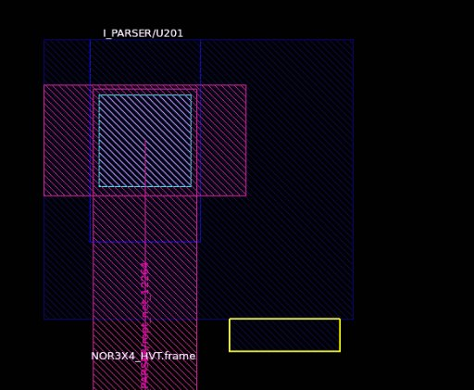
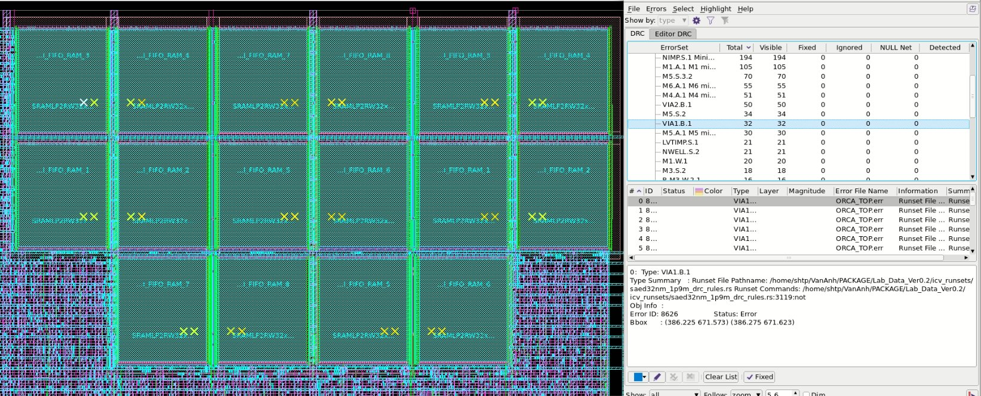
PROBLEM
VIA3.B.1
VIA6.B.1
M1.W.1
M1.W2.S.1

Slide 28
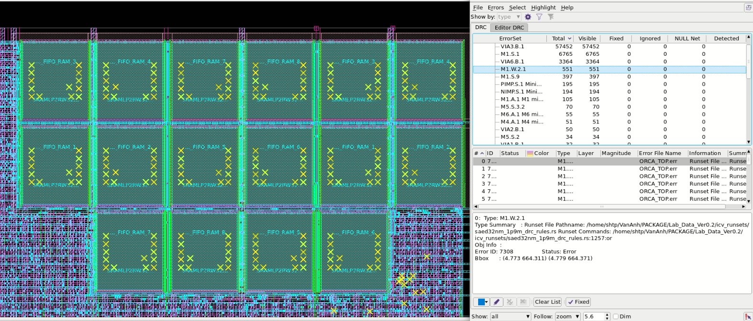
PROBLEM
M1.W2.S.1

Slide 29
4. PV
Block ORCA_TOP

Slide 30
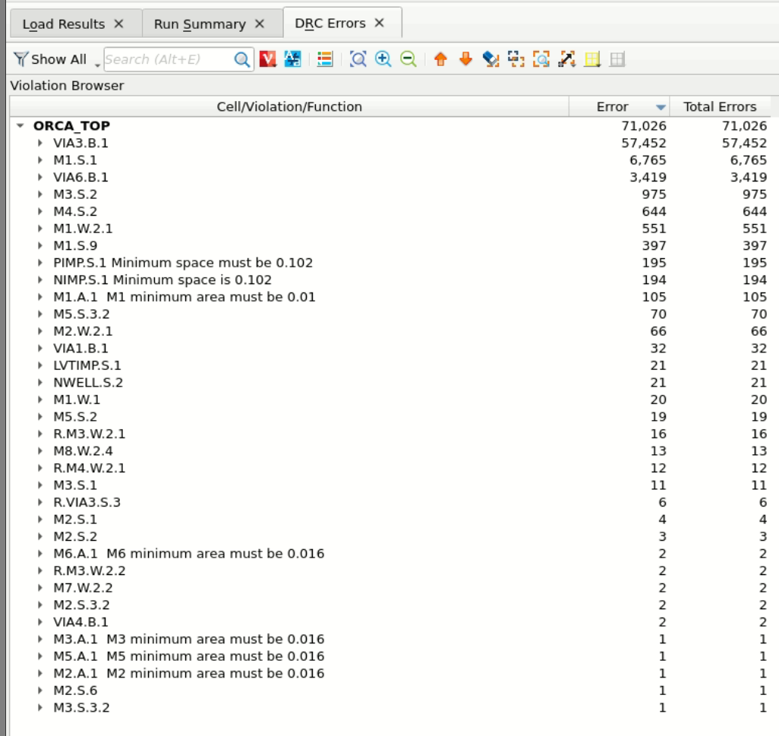
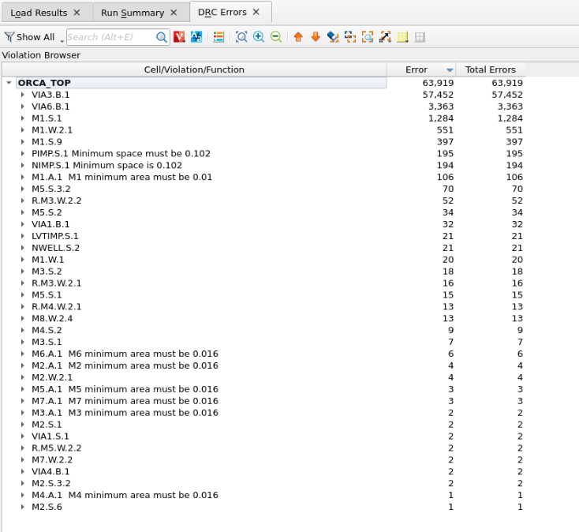
DRC_ICV – Before vs After

Slide 31
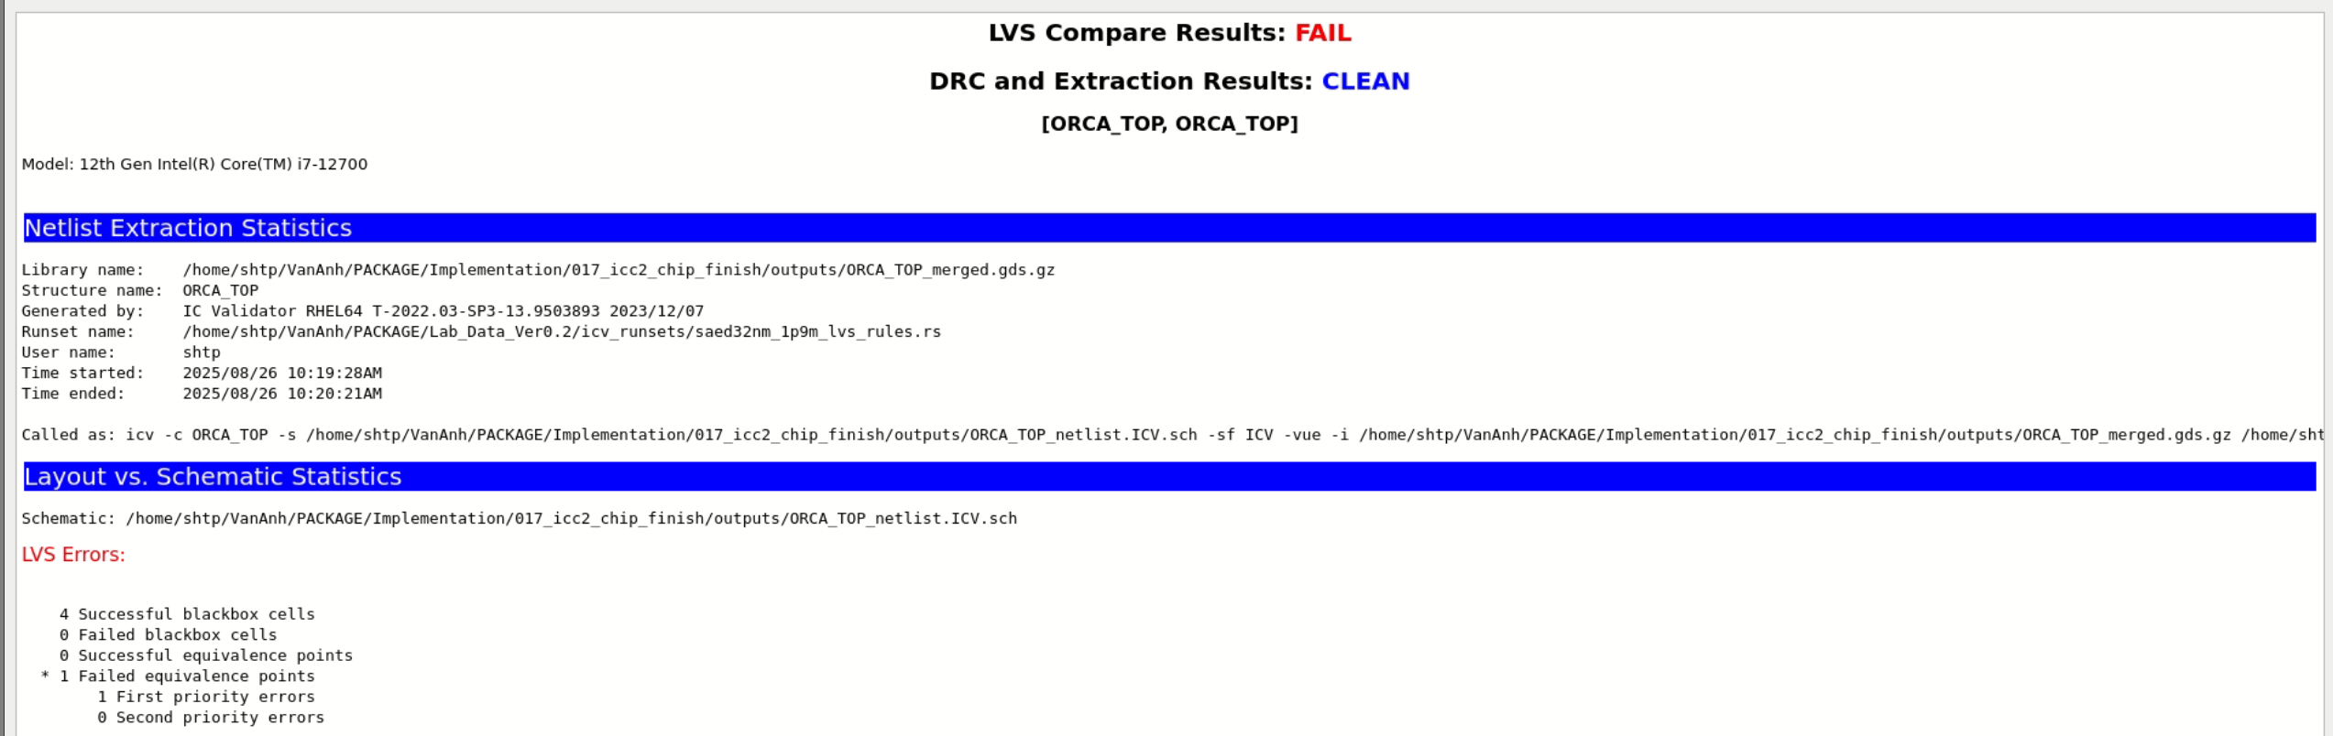
LVS - ICV

Slide 32
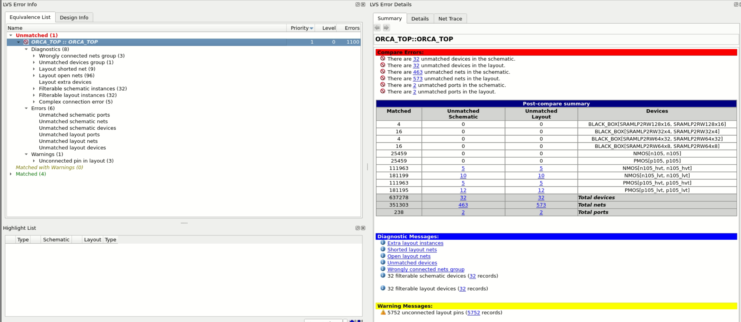
LVS – ICV Before

Slide 33
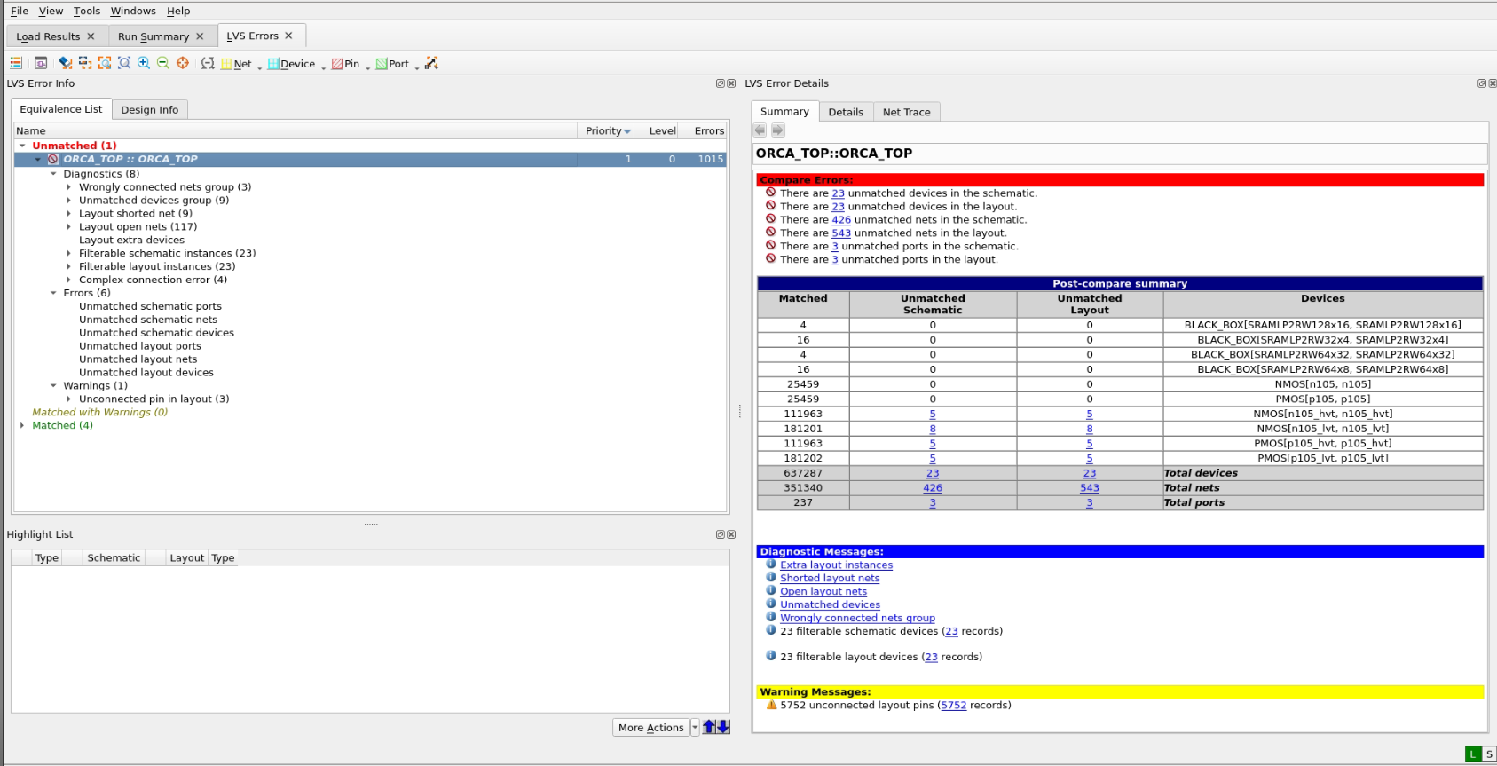
LVS – ICV After

Slide 34
5. LEC
Block ORCA_TOP

Slide 35
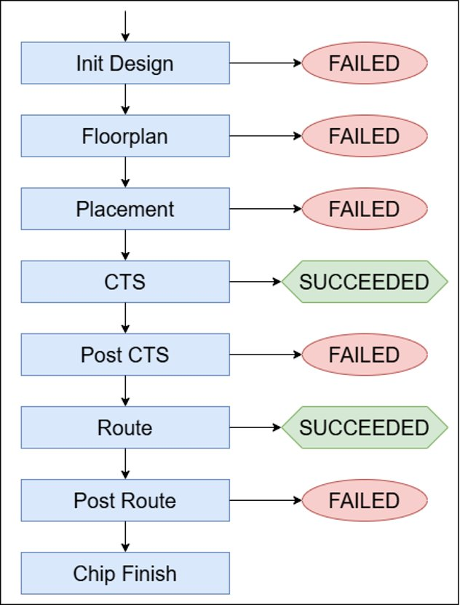
LEC

Slide 36
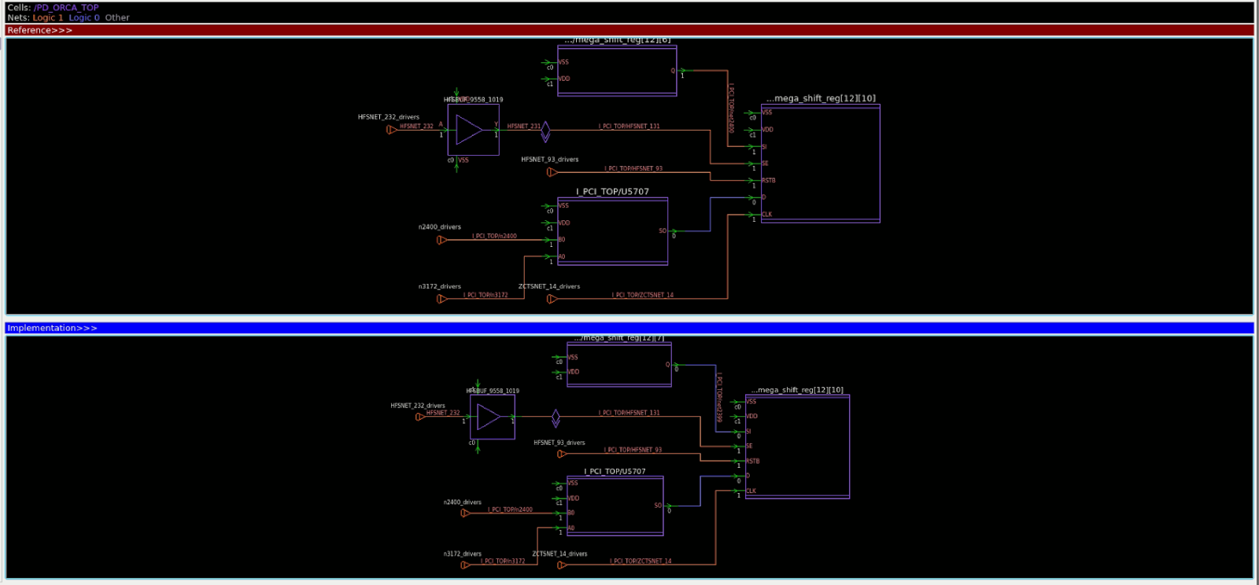
FAIL – POST ROUTE

Slide 37
6. Conclusion
Block ORCA_TOP

Slide 38
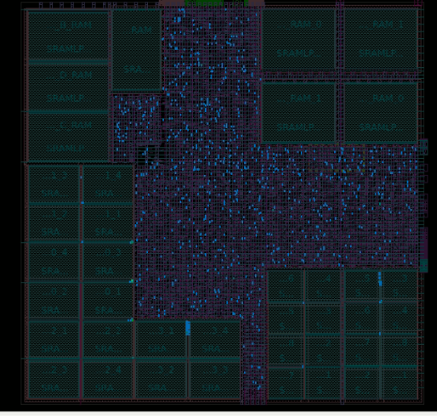
Conclusion - Experience
Pins / Ports Placement
Hard Macro Orientation
Open Nets

Slide 39
Conclusion - Orientation
Fix DRC and LVS violations.
Fix setup timing, no more violations.
Optimize power.
Identify the root cause of the LEC failure and attempt to fix the issue.
Fix open nets using a script file.

